Slide 1
Digital Logic for VLSI
By- CHANDRAMOULI HALDAR

Slide 2
Introduction to Digital Logic
Digital systems operate using Binary Values (0 and 1)
Based on Boolean Algebra
Implemented using Logic Gates
Foundation of all VLSI Circuits
Every microprocessor, memory, ASIC starts from digital logic

Slide 3
Binary Number System
Base-2 number system
Only two digits: 0 and 1
1 bit = smallest unit of digital data
Used because transistors operate in:
  ON state (1)
  OFF state (0)

Slide 4
Why Binary System is Used
Transistors behave like switches:
  ON → Current flows → Logic 1
  OFF → No current → Logic 0
Binary system is simple and reliable.
Less error compared to analog signals.
Easy to implement inside integrated circuits.

Slide 5
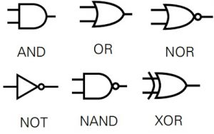
Basic Logic Gates
AND → Output is 1 only if all inputs are 1.
OR → Output is 1 if any one input is 1.
NOT → Inverts the input.
NAND → Opposite of AND.
NOR → Opposite of OR.
XOR → Output is 1 if inputs are different.
XNOR → Output is 1 if inputs are same.

Slide 6
Boolean Algebra Basics
Important rules used for circuit simplification:
  A + 0 = A (OR with 0 does not change value)
  A · 1 = A (AND with 1 does not change value)
  A + A’ = 1
  A · A’ = 0
  A + A = A
These rules help:
Reduce number of gates, Reduce chip area, Reduce power consumption

Slide 7
From Transistor to Chip
A transistor is a small electronic switch.
Multiple transistors form a logic gate.
Multiple gates form combinational or sequential circuits.
These circuits form blocks like ALU, memory, registers.
Millions or billions of such blocks form a VLSI chip.

Slide 8
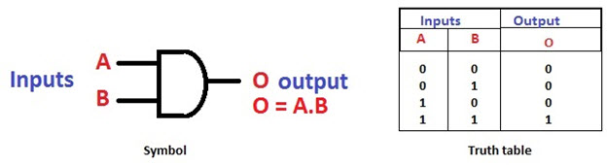
AND Gate

Slide 9
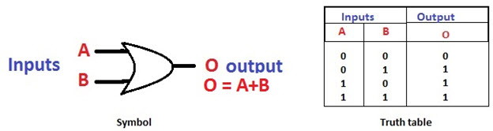
OR Gate

Slide 10
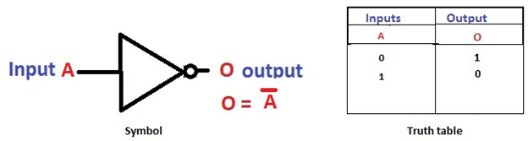
NOT Gate

Slide 11
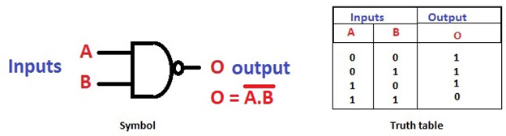
NAND Gate

Slide 12
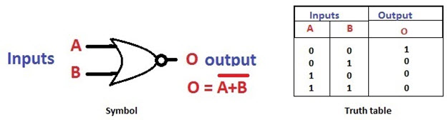
NOR Gate

Slide 13
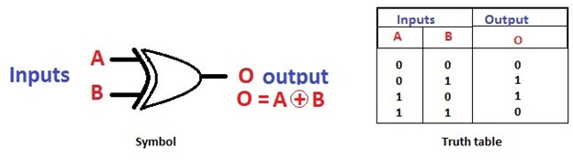
XOR Gate
O = AB + AB

Slide 14
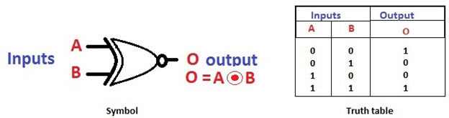
XNOR Gate
O = AB + AB

Slide 15
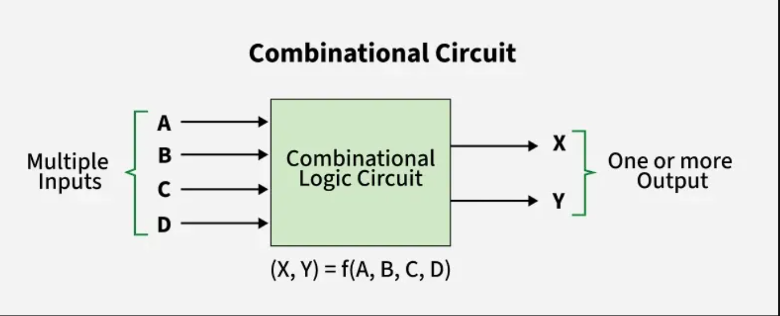

Slide 16
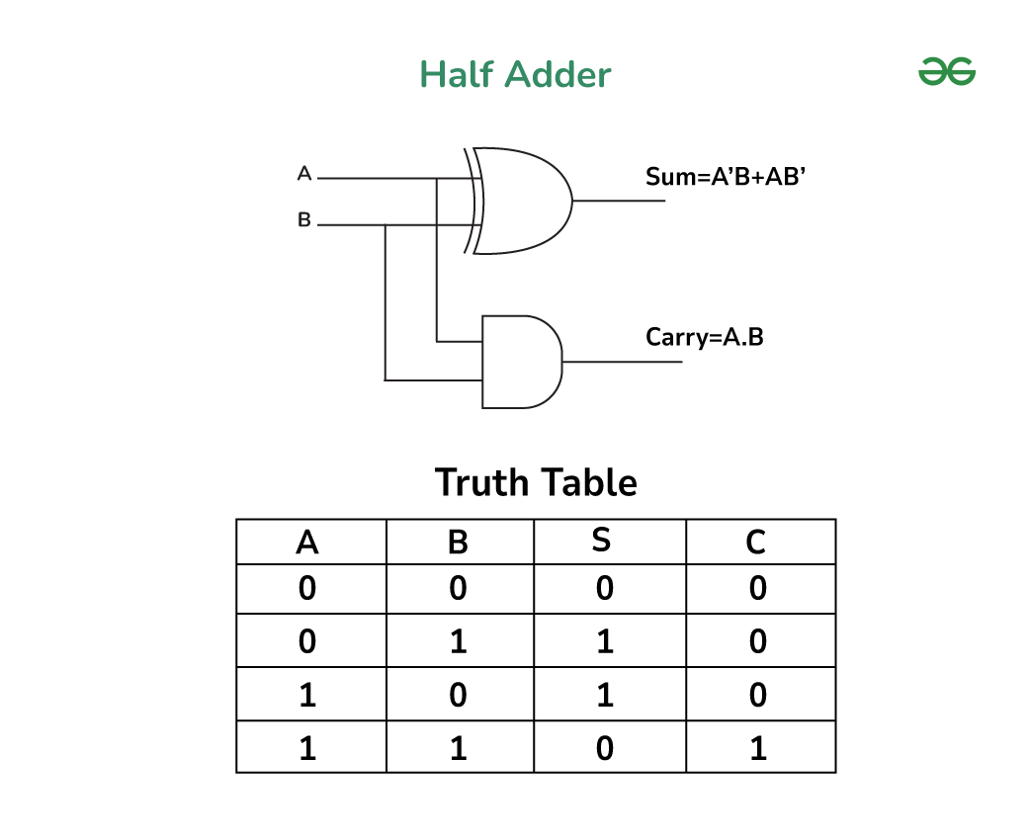

Slide 17
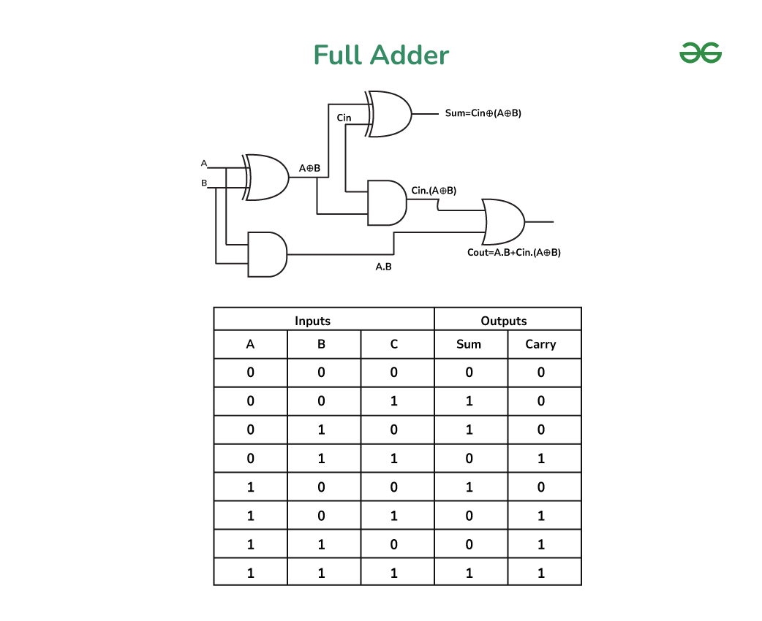

Slide 18
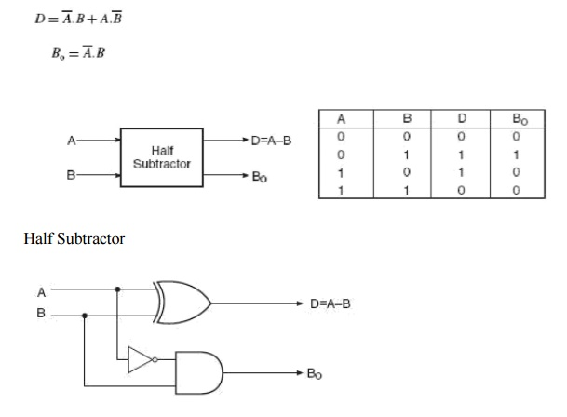
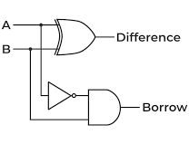

Slide 19
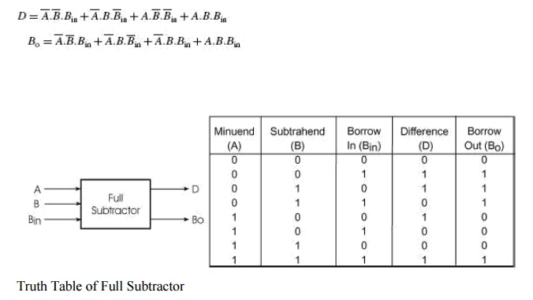
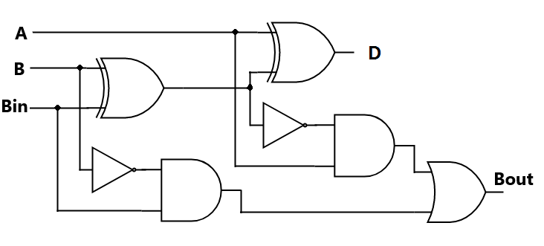

Slide 20
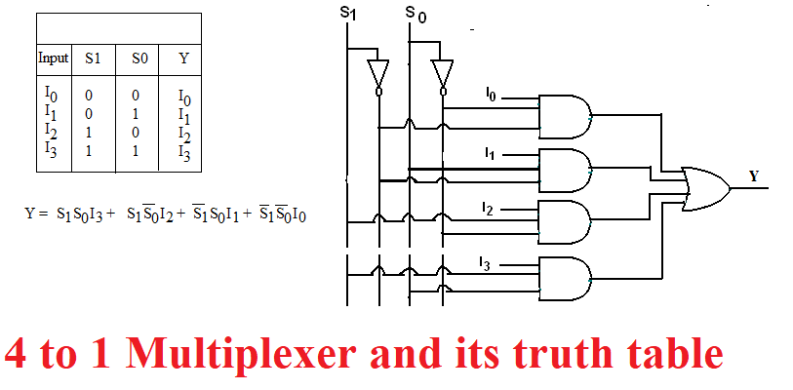

Slide 21
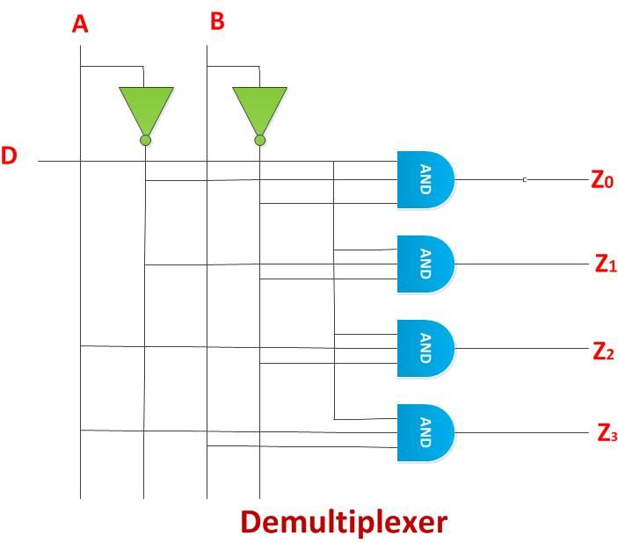
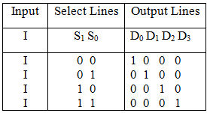

Slide 22
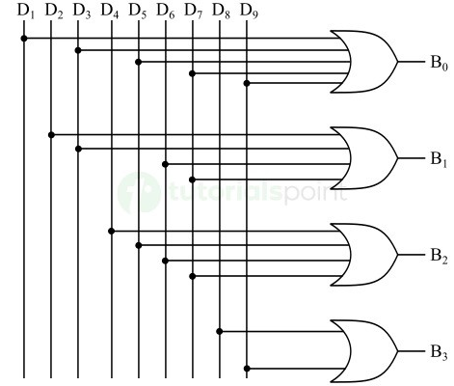
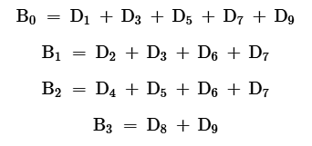
Decimal | BCD Code
 | B₃ | B₂ | B₁ | B₀
0 | 0 | 0 | 0 | 0
1 | 0 | 0 | 0 | 1
2 | 0 | 0 | 1 | 0
3 | 0 | 0 | 1 | 1
4 | 0 | 1 | 0 | 0
5 | 0 | 1 | 0 | 1
6 | 0 | 1 | 1 | 0
7 | 0 | 1 | 1 | 1
8 | 1 | 0 | 0 | 0
9 | 1 | 0 | 0 | 1

Slide 23
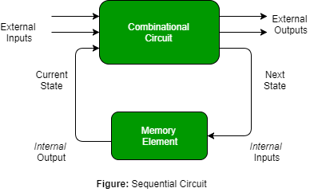

Slide 24
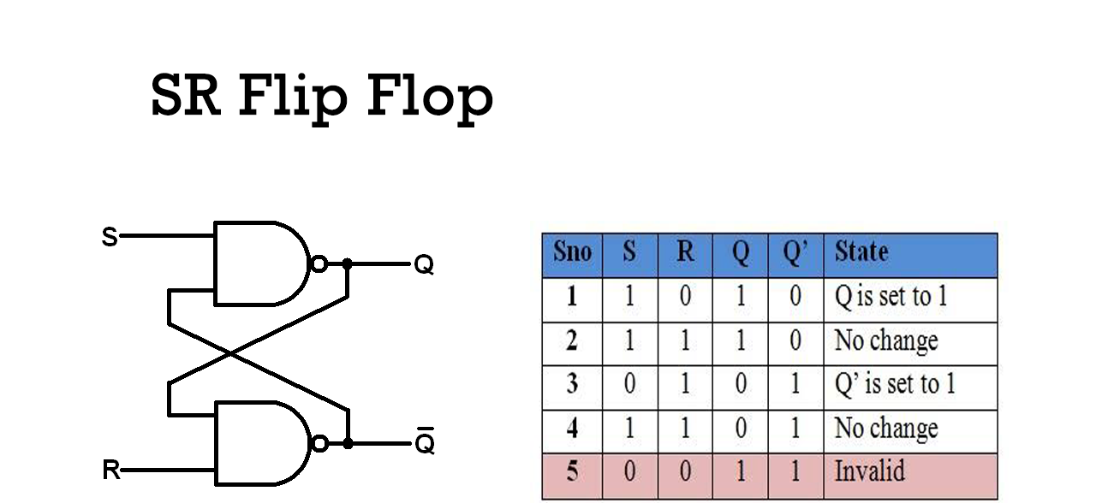

Slide 25
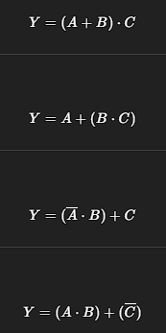
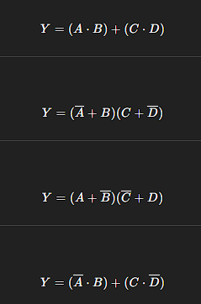
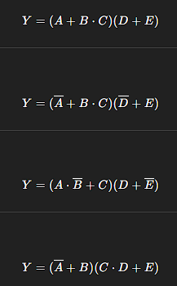
PRACTICE

Slide 26
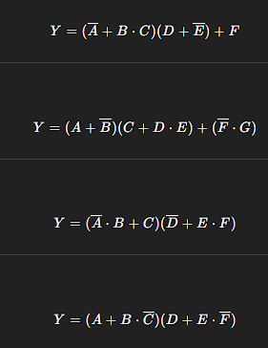
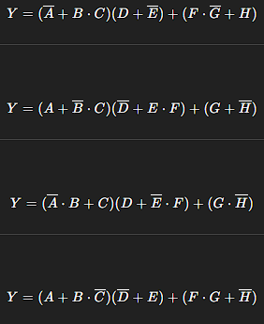
PRACTICE

Slide 27
THANK YOU!
The class will end at 1:30, not before that.

